Slide 1
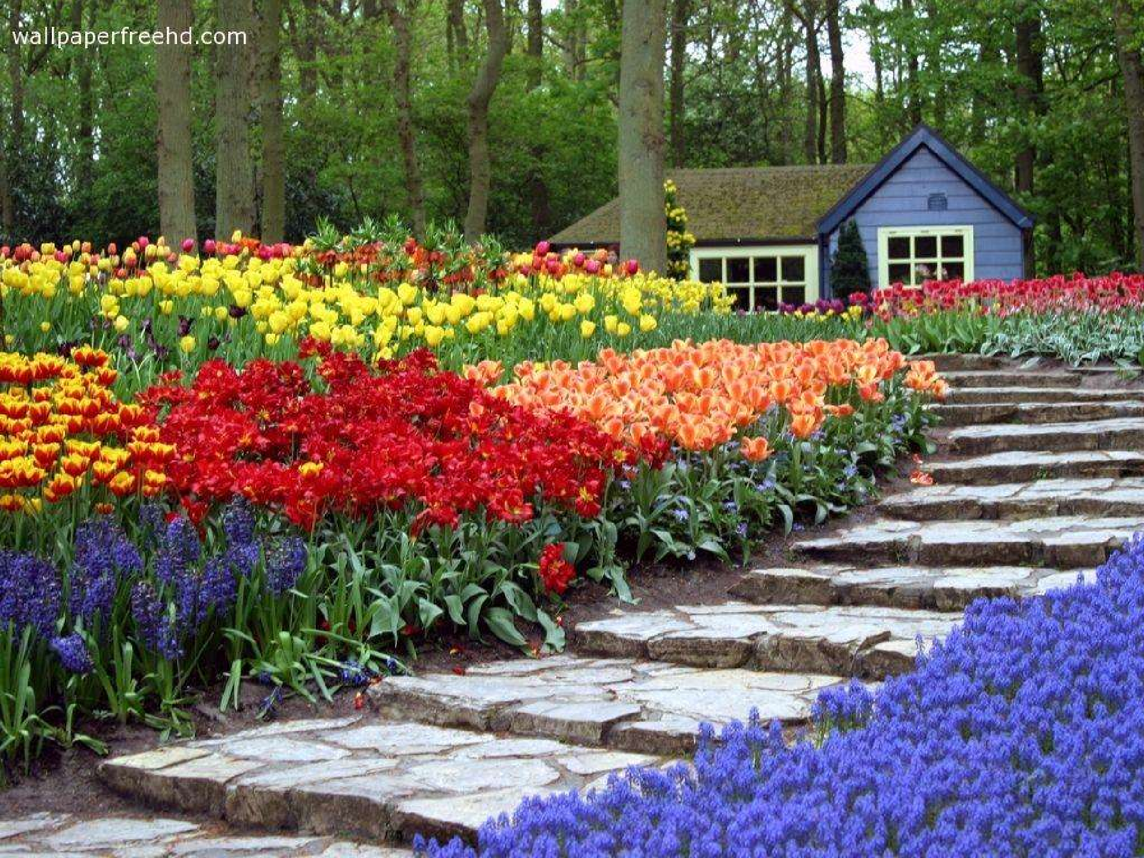



WELCOME

Slide 2
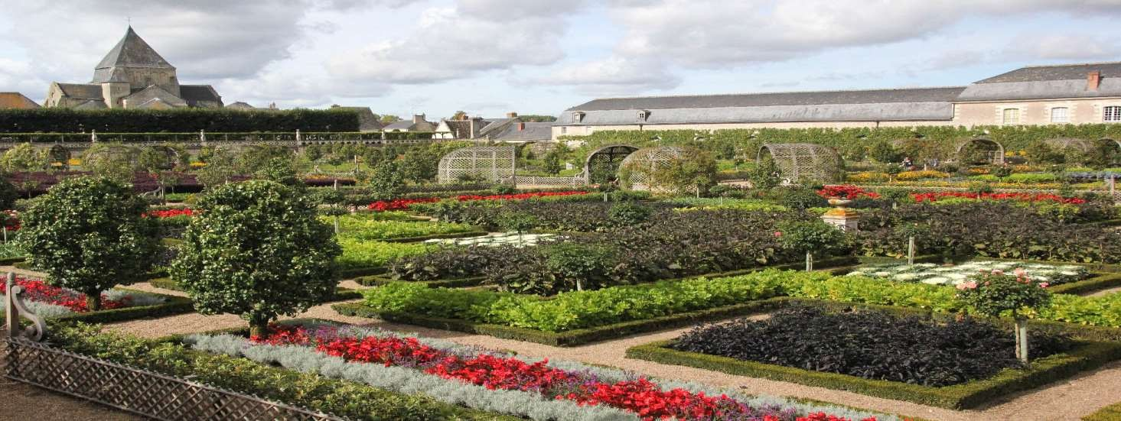
TYPES & STYLES OF ORNAMENTAL GARDENING

Slide 3
TYPES OF GARDENS
FORMAL GARDENS
Gardens which were strictly formal, symmetrical and geometrical resembling a carpet are called Formal Gardens
Eg. Moghul gardens, Persian gardens, Italian[Roman] & French gardens

Slide 4
INFORMAL GARDENS
Gardens which laid no emphasis on formality and which resembles nature are called Informal Gardens.
Eg. Japanese & British Gardens
SPECIAL TYPE OF GARDENS
Roof garden
Vertical garden
Water garden
Marsh or Bog garden
Terrariums

Slide 5
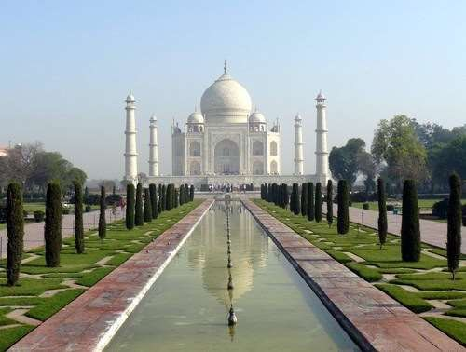
FORMAL GARDEN

Slide 6
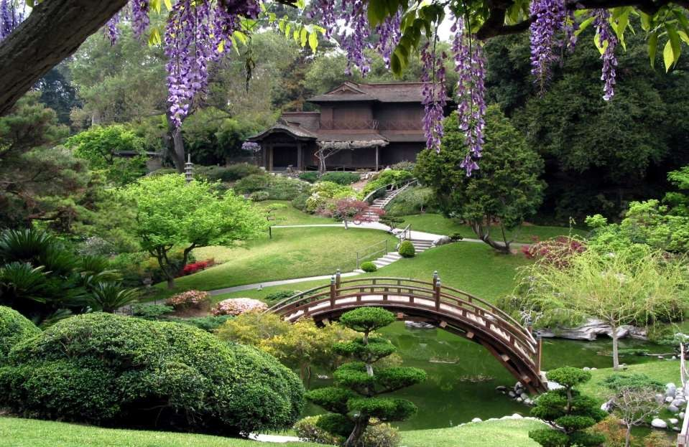
INFORMAL GARDEN

Slide 7
MOGHUL GARDEN
The great Moghul Emperor Babur had high aesthetic sense and was fond of gardens.
Moghul gardens are synonymous of formal style of gardening which is an extended dynasty of primitive Persian garden is Char Bagh design.
Moghul gardens can be categorised into two: i) Pleasure gardens of Kings and Queens ii) Tomb garden

Slide 8
General Features of Moghul Gardens
Moghul gardens were extended design of paradise garden of Persia
Garden area is divided into four plots by water channels.
These four channels represent four rivers of life. The running water provides coolness and freshness to the garden.
The water pool created in the centre with over flowing water
Fountains, cascades are linked to central pool to create scenic beauty

Slide 9
Terraces
Key Features of Moghul Gardens
Terraces are components to maintain the proportion of land for extended view irrespective of topography of the area 7 terraces symbolize 7 planets. The entrance is located at the lowest terrace.
Moghul emperors came from a hilly country, the idea of building a garden in terraces came to them naturally.

Slide 10
Running Water
Water channels were paved with tiles of brilliant blue colour to reflect the sky and give impression of depth.
Site and design
A perennial river, the slope of a hill and river banks were the places selected for this purpose.
A typical Moghul garden is square or rectangle in shape. It is not merely a garden but serves the purpose of fort, residence and a place for recreation.

Slide 11
High Protecting Wall
Moghul gardens are protected by a high strong wall.
The presence of high wall was protection against enemy and hot winds of summer.
Entrance
Entrance is generally tall and gorgeous. Doors are huge and strong wooden structure studded with heavy iron nails and spikes

Slide 12
Baradari
It is a canopied building with twelve open doors ie., three in each direction.
From baradari, one can sit and enjoy the fresh breeze and watch dark clouds and birds in the sky.
The masonry pillars of baradari were painted with favourite design of bouquets of flowers in vases and the floor was furnished with thick carpets and cushions

Slide 13
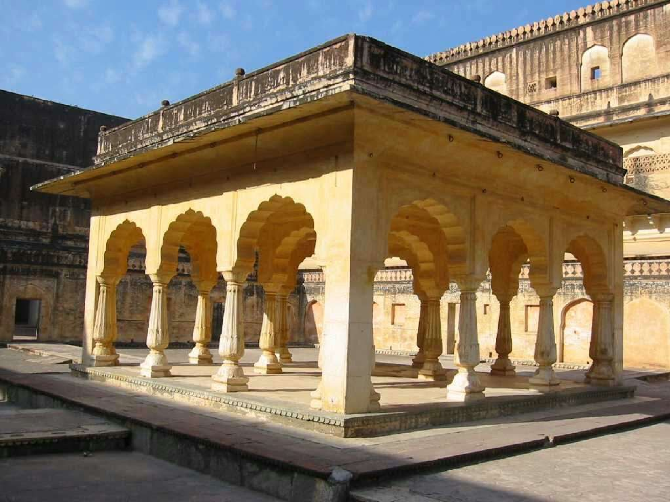
BARADARI

Slide 14
Scented flowers
The flowers in Moghul gardens are mostly scented in nature and highly colourful.
The colourful effects were created by massing mixed coloured annuals
Mixed colours have been preferred rather than mono, complementary or contrast colours

Slide 15
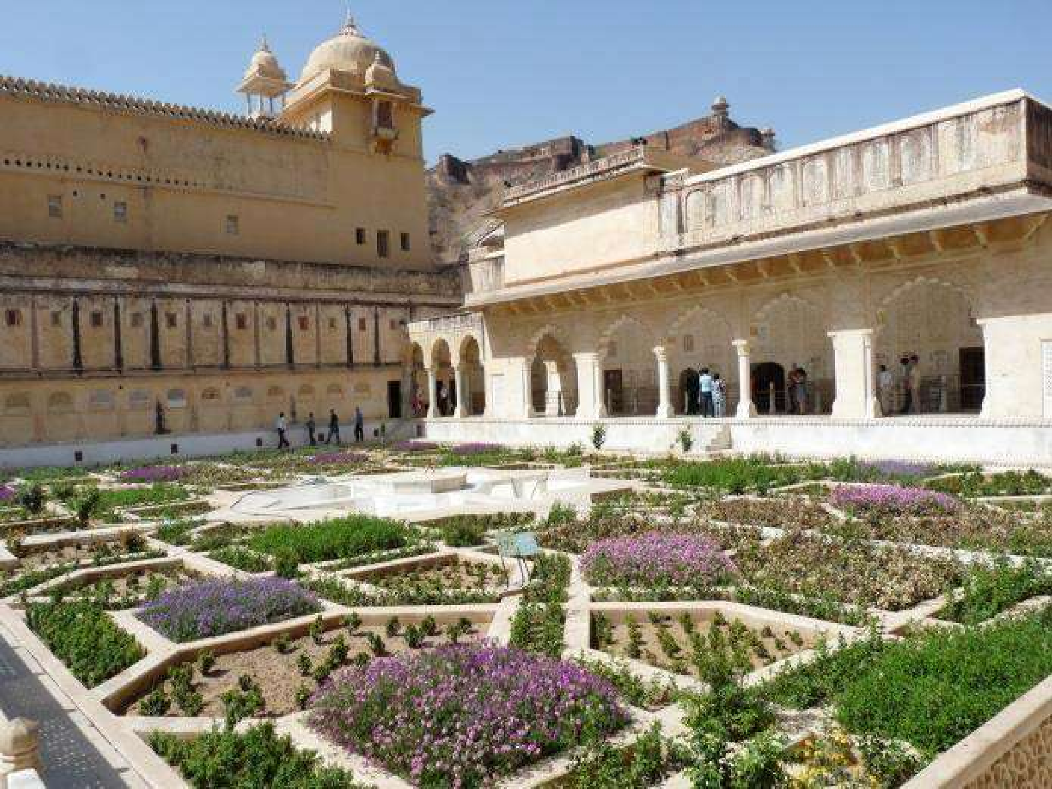

Aram Bagh Garden at AGRA

Slide 16
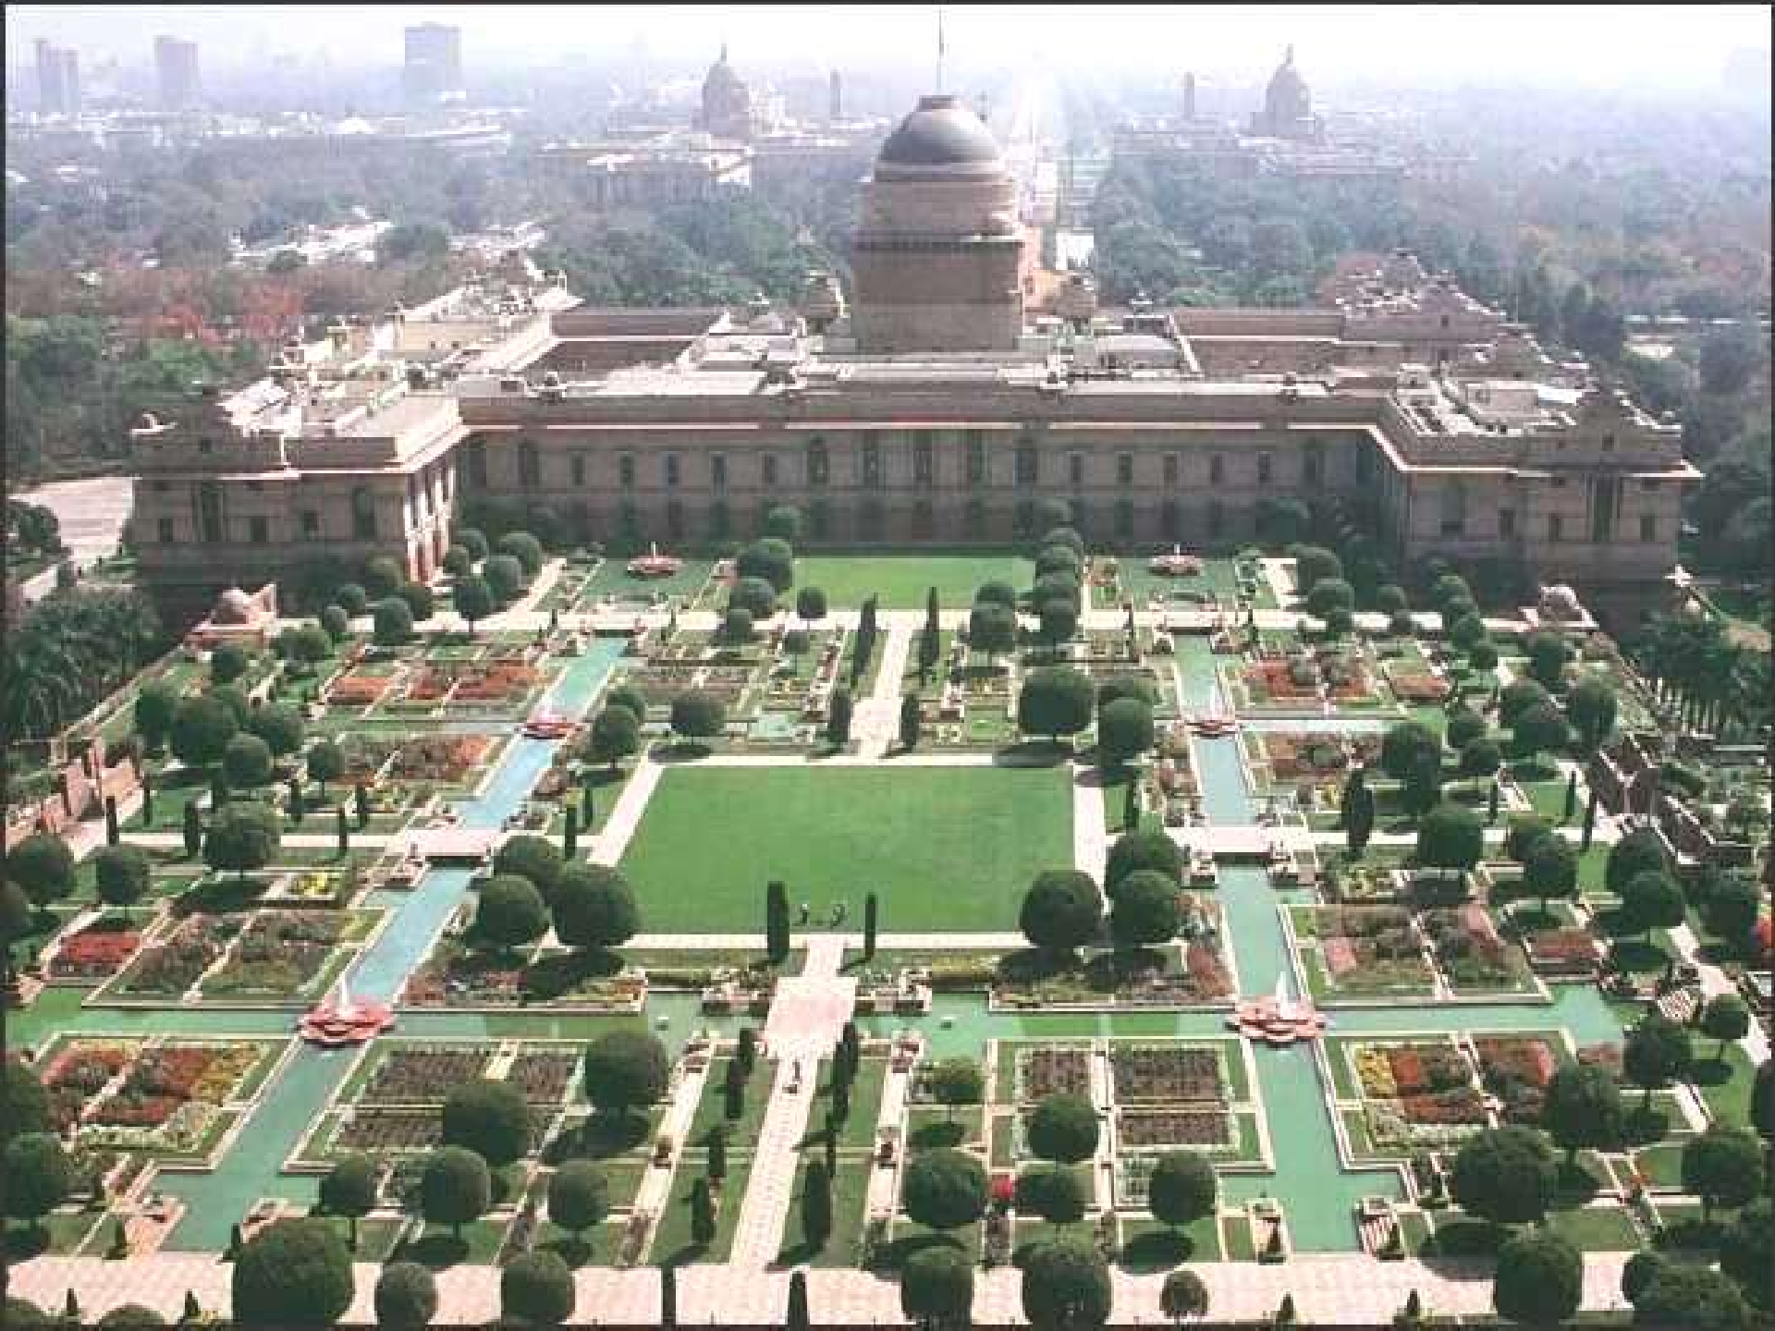


Rashtrapathi Bhavan

Slide 17
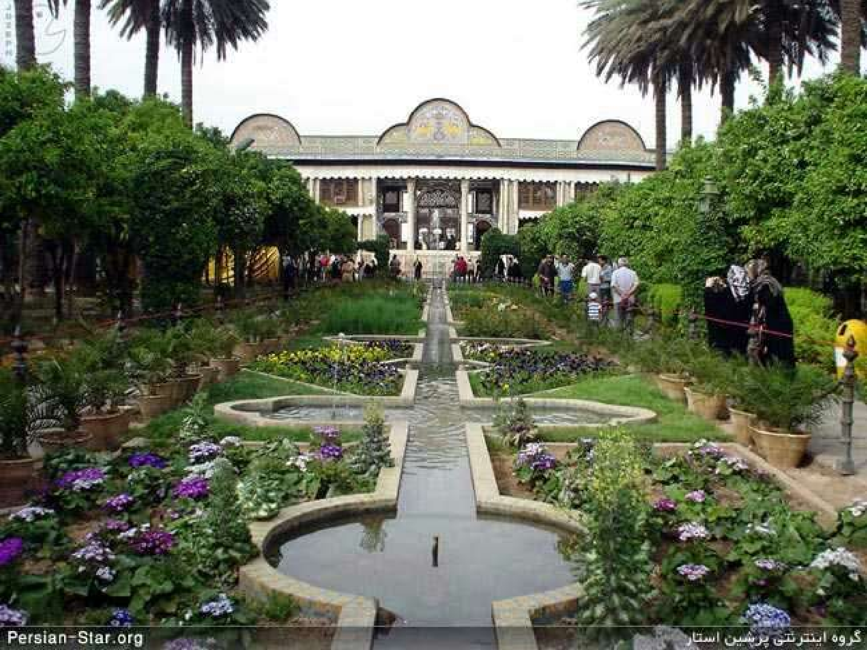



Persian Garden

Slide 18
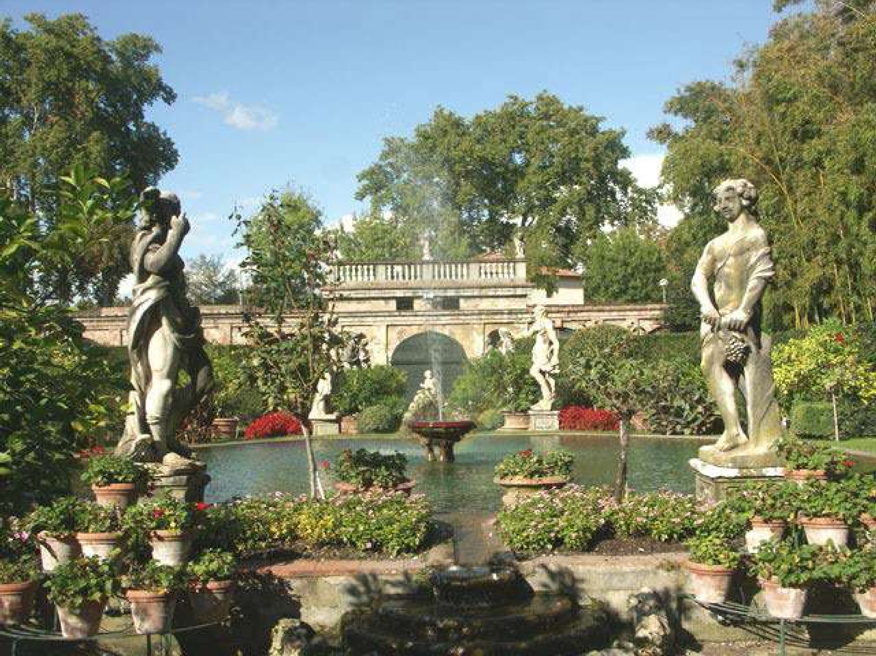






Slide 19
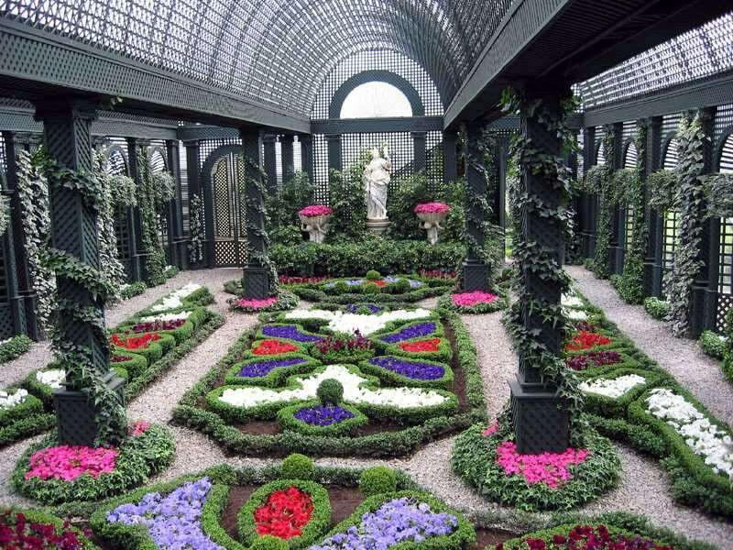
FRENCH GARDEN

Slide 20
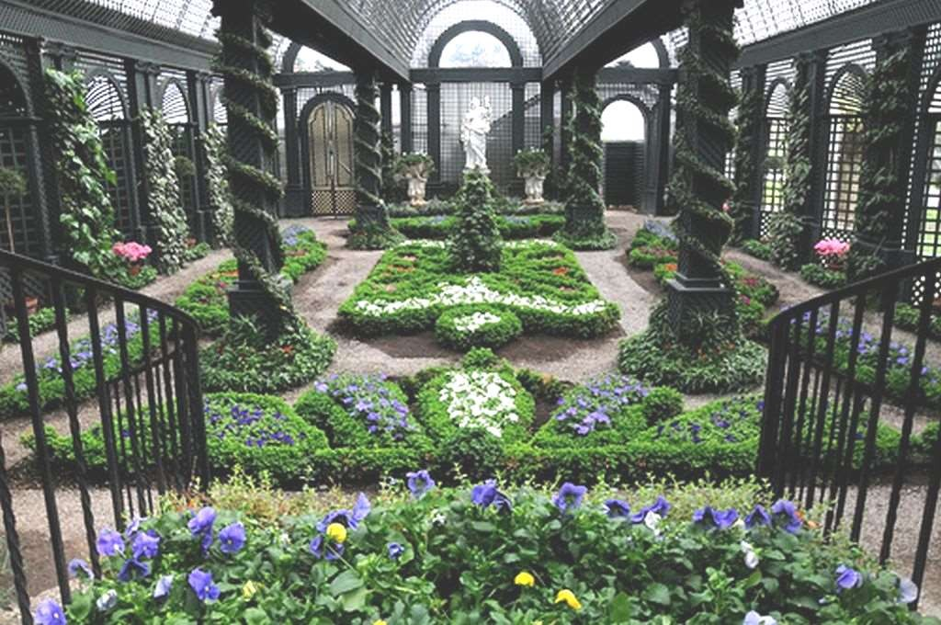
FRENCH GARDEN

Slide 21
INFORMAL GARDENS
JAPANESE GARDEN
Japanese gardens type is ‘’Nature in Miniature’’ which enables them to meditate, be in harmony with nature.
These gardens were planned with so much care though they appear so casual.
Remains beautiful in winter

Slide 22
Features of Japanese Gardens
Pond
Streams
Waterfalls
Fountains
Wells
Islands
Bridges
Stones
Stone Lanterns
Pagoda, Fences& Gates

Slide 23
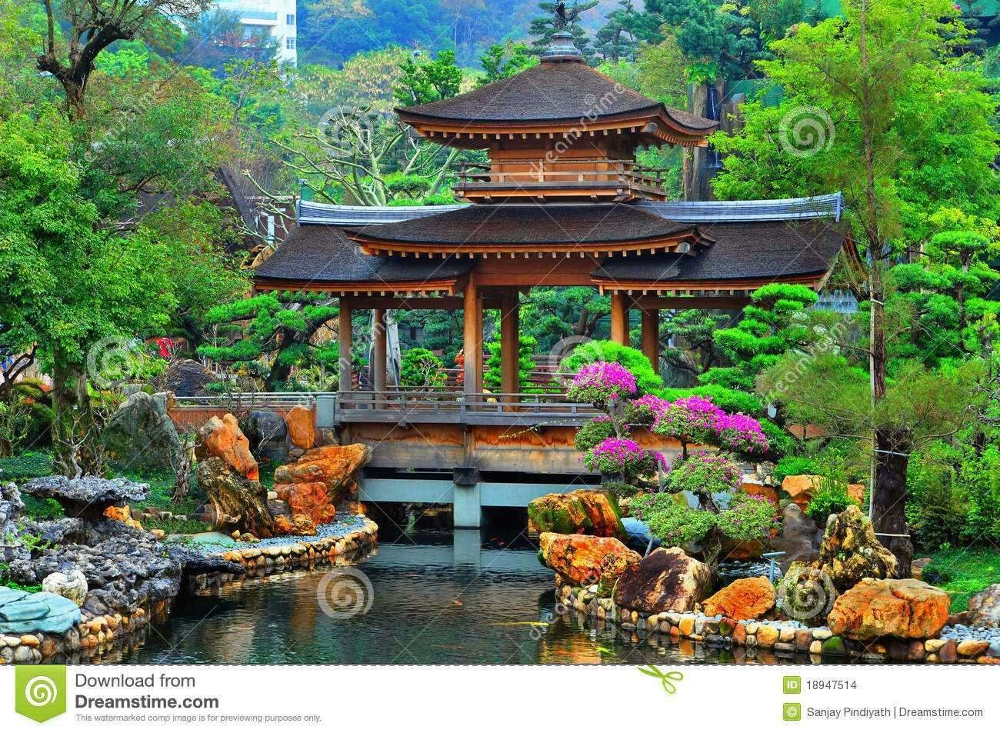
PAGODA

Slide 24
Key features of Japanese garden
They are nature recreated in miniature.
They aid a person to meditate peacefully.
The colourful leaves or flowers which distract the eyes are avoided.
Totally informal in design.

Slide 25
FORMS OF JAPANESE GARDENS
Hill Gardens
Japanese Tea Gardens
Flat Gardens

Slide 26
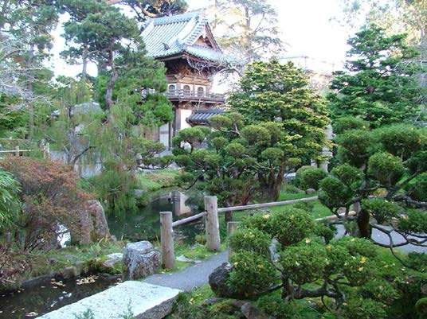
JAPANESE GARDEN

Slide 27
BRITISH GARDEN
English gardens are most beautiful gardens among all European gardens
UK enjoys the typical grassland climate with well distributed rainfall
This favours for the growth of herbaceous perennials
Gardening is a high cost technology and British were rich enough to afford luxury.
Britishers are very fond of flowers.

Slide 28
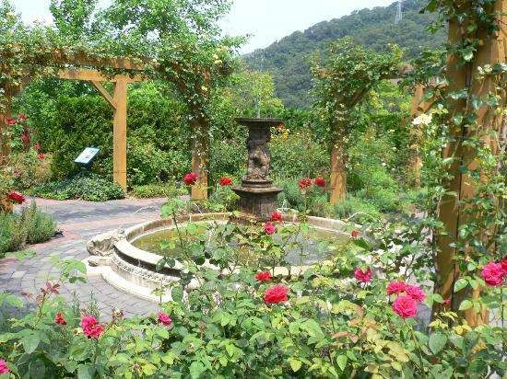
BRITISH GARDEN

Slide 29
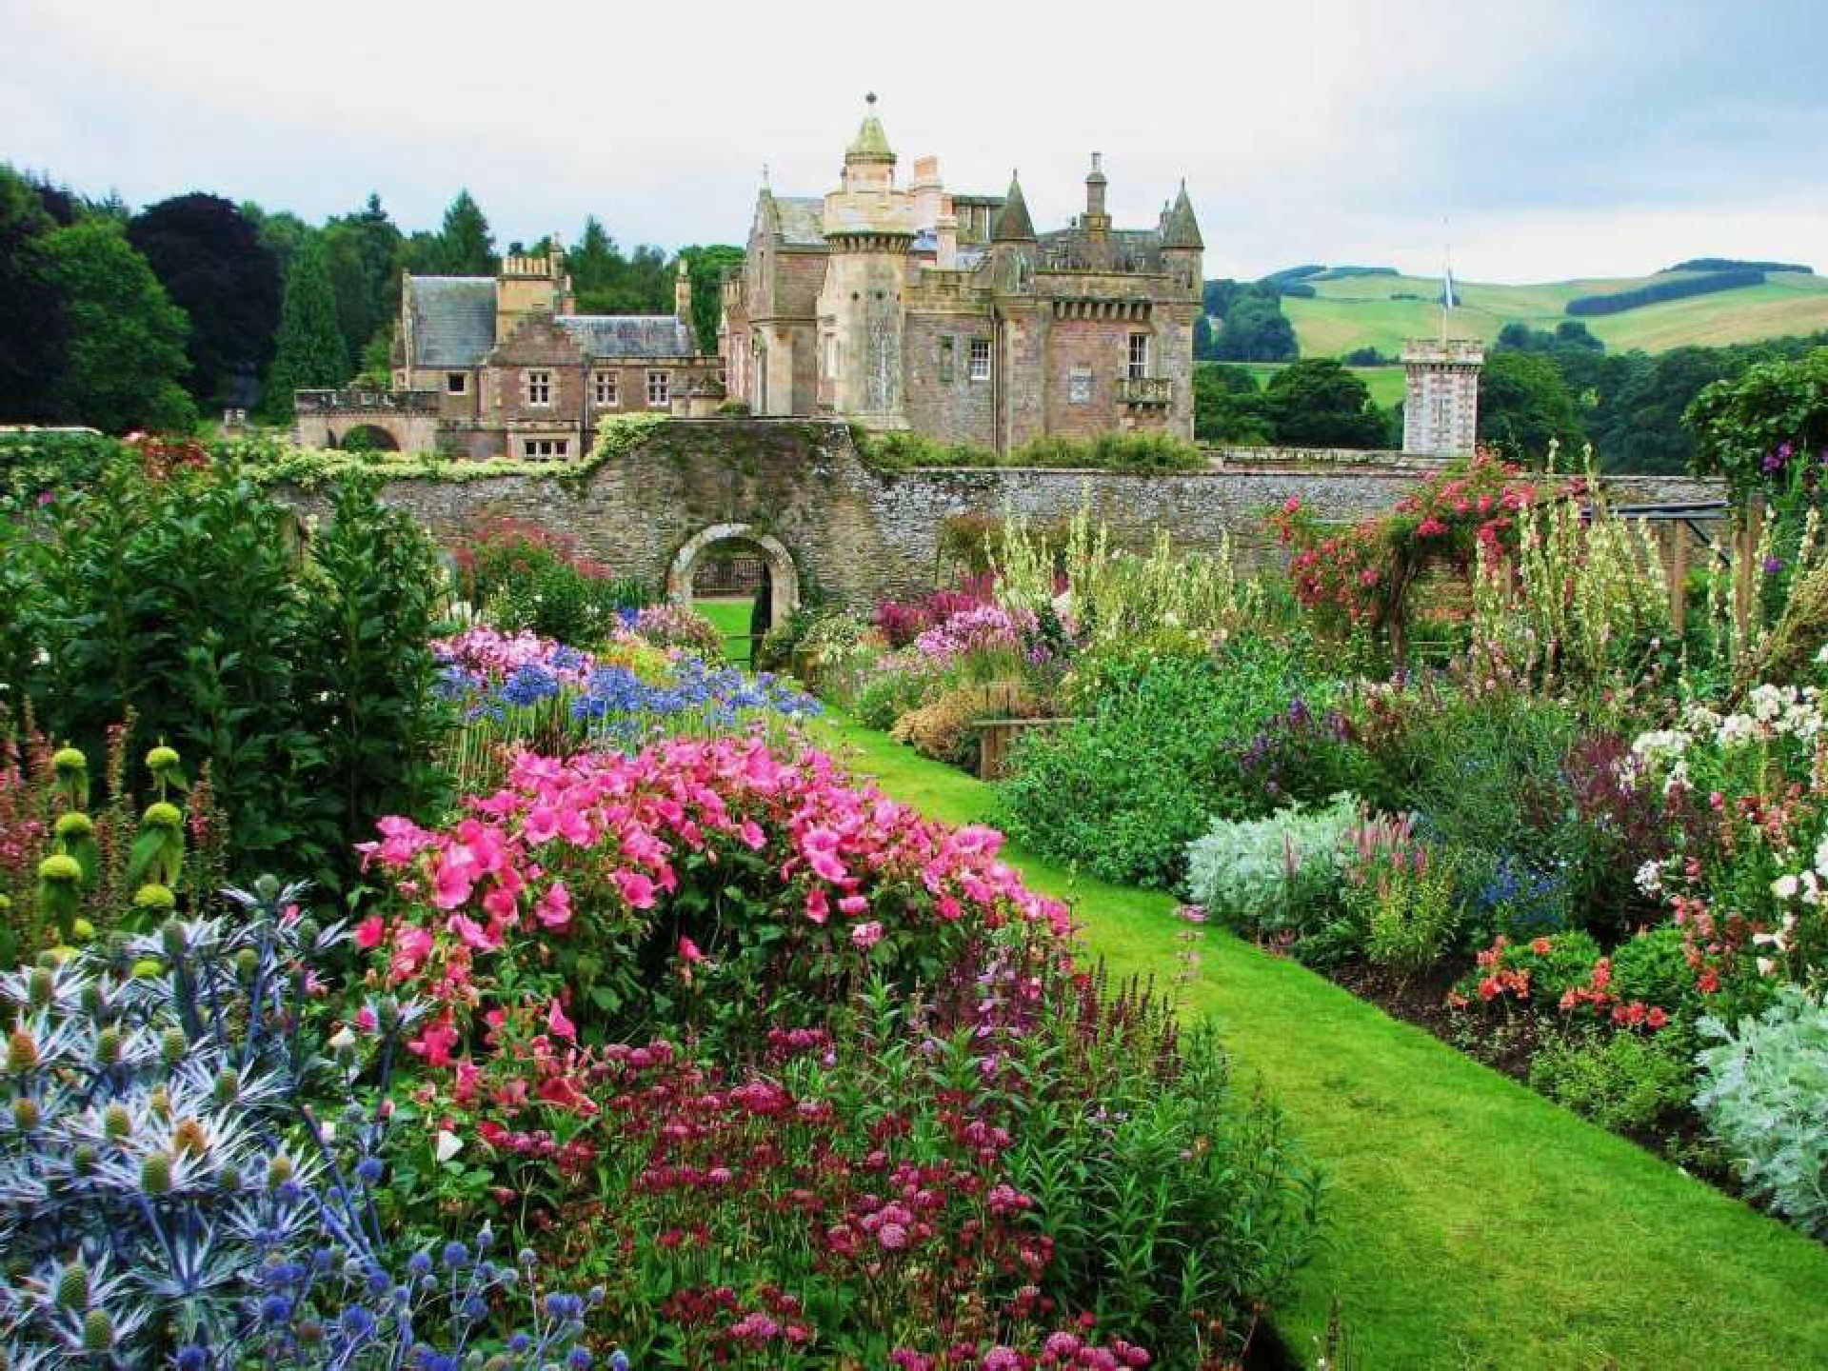

Slide 30
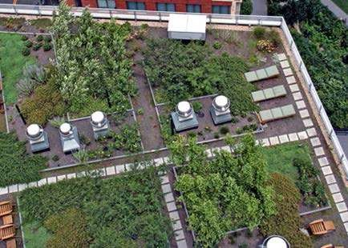
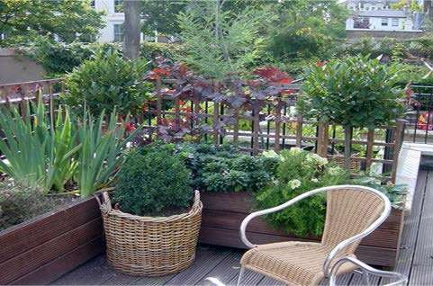
SPECIAL TYPE OF GARDENS
ROOF GARDENING

Slide 31
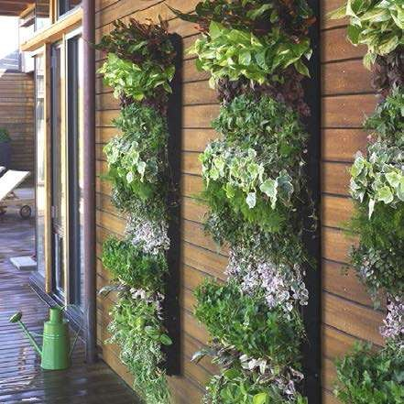
VERTICAL GARDEN

Slide 32
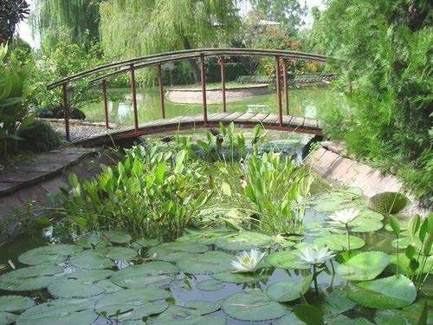
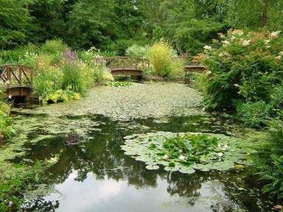
WATER GARDEN

Slide 33
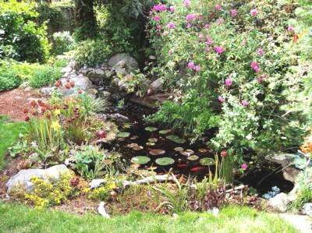
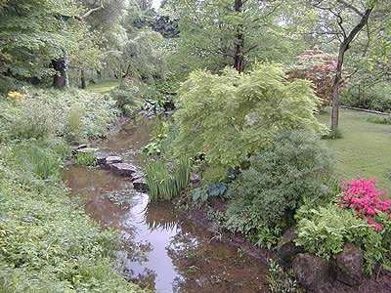
MARSH OR BOG GARDEN

Slide 34
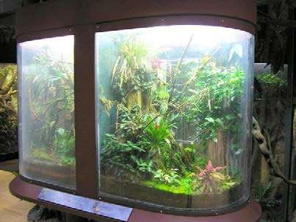
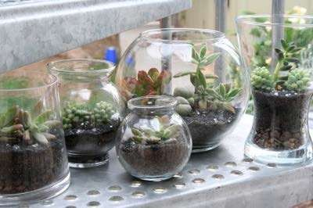
TERRARIUM

Slide 35
SOME INDIAN - STYLE GARDENS
Hindu type of garden
Ashokavanam
Nandanavanam
Tapovanam
Brindavanam
Raajavanam

Slide 36
Source
Images : agridir.in & others via google Theory : www.agridir.in

